Slide 1

Final Walkthrough
Big Data
Prof Juan Rodriguez

Slide 2
Election 2024
Sentiment Analysis
01.
Team Avengers
Prachet Balaji, Dominique Eberhard, Sai Nishanth Mettu, Neha Saji Joseph, David Liu, Qile Asher Zhou

Slide 3


Introduction
Social media has reshaped how people get information, discuss issues, and form opinions. Platforms like Twitter and Reddit have become spaces for fast communication and user-generated content – the new public square. In this project we aim to use big data technology to do sentiment analysis on a large scale on social media posts related to the 2024 election, to see how social media users feel about the election and politics.

Slide 4
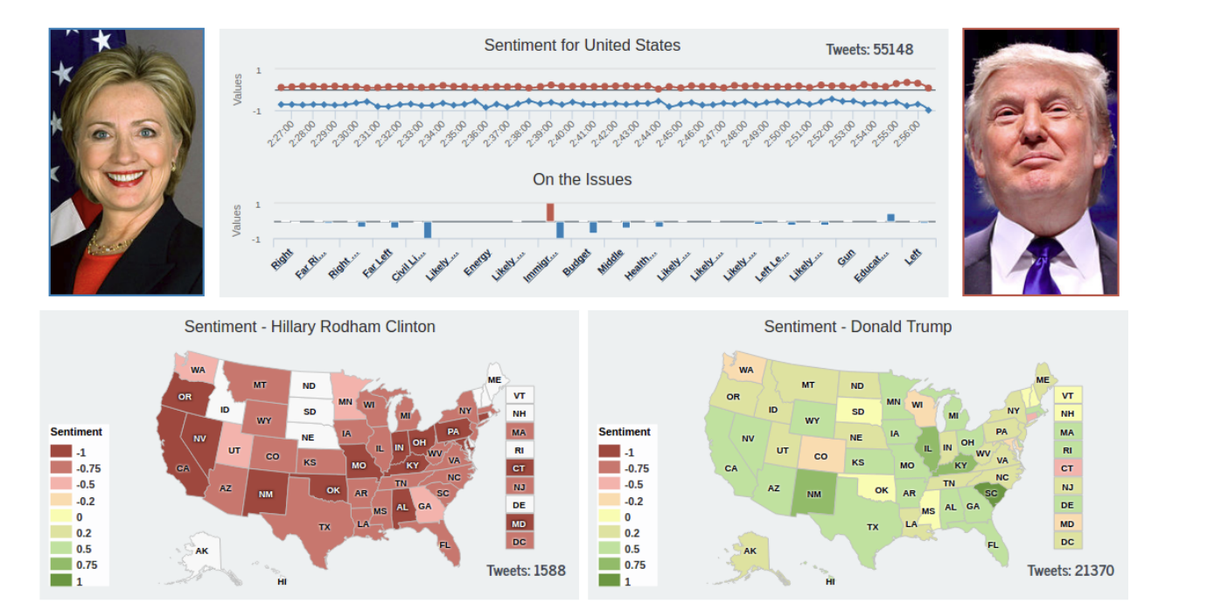
Problem Statement..
Social media is reshaping how people discuss politics and influence public opinion, especially during elections. With millions of posts shared daily, understanding public sentiment on platforms like Twitter and Reddit is crucial. Traditional polling falls short in scale and speed, making big data-powered sentiment analysis essential to uncover real-time insights about voter behavior and political trends during the 2024 election.
For example, during the 2016 U.S. presidential election, social media shaped narratives, spread misinformation, and influenced voter sentiment. Public discussions on platforms like Twitter mirrored major political events, affecting perceptions of candidates and issues. Using big data sentiment analysis, we can track these shifts in real time, providing valuable insights into evolving public opinion for policymakers, analysts, and researchers.

Slide 5

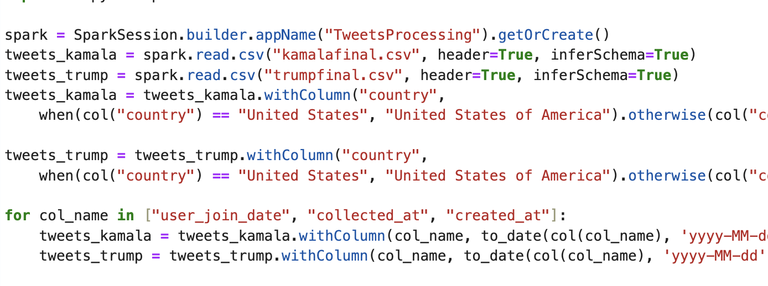
Technologies & Big Data concepts used..
This NLP problem involved analyzing large-scale social media data to extract patterns and sentiments effectively.
Apache Spark made this process significantly easier by enabling distributed and parallel data processing, allowing us to handle millions of posts efficiently.
Spark's in-memory computing reduced the latency typically associated with traditional MapReduce frameworks, accelerating tasks like tokenization, N-Gram extraction, and sentiment scoring.
Additionally, its integration with libraries for natural language processing (NLP) streamlined the workflow, making it possible to process unstructured text data seamlessly and generate actionable insights from vast datasets.

Slide 6
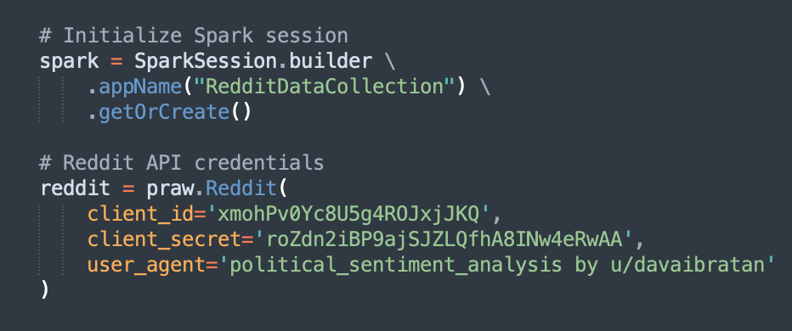
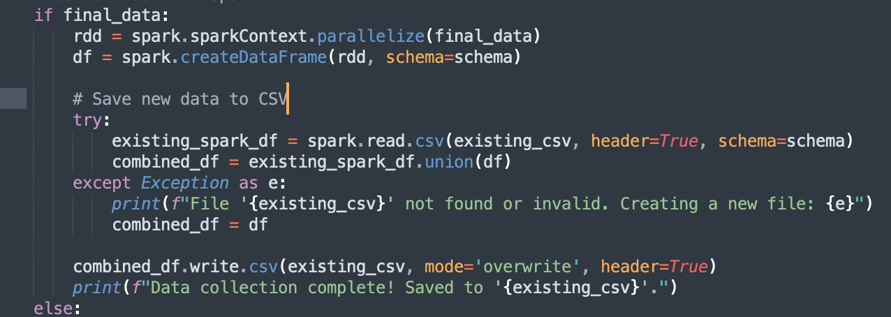
Data Collection using Big Data
Parallelized Web Scraping - Twitter and Reddit Data (Millions of Rows ~ GB of size)

Slide 7
Contd..
In this project, we implemented parallelized web scraping to collect massive datasets from Twitter and Reddit, comprising millions of rows and spanning several gigabytes in size.
Using Apache Spark, we distributed the scraping tasks across multiple nodes to efficiently handle the high volume of data. We leveraged Spark’s RDD and DataFrame APIs to parallelize the scraping of posts, comments, and metadata from both platforms, ensuring that each worker processed a different subset of URLs concurrently.
By incorporating Python libraries such as Tweepy for Twitter API access and PRAW for Reddit API access, we were able to fetch real-time data efficiently.
Post-scraping, the data was processed and stored in a distributed file system for further analysis, making the entire pipeline scalable and robust to handle large-scale data collection from multiple sources in a distributed manner.

Slide 8
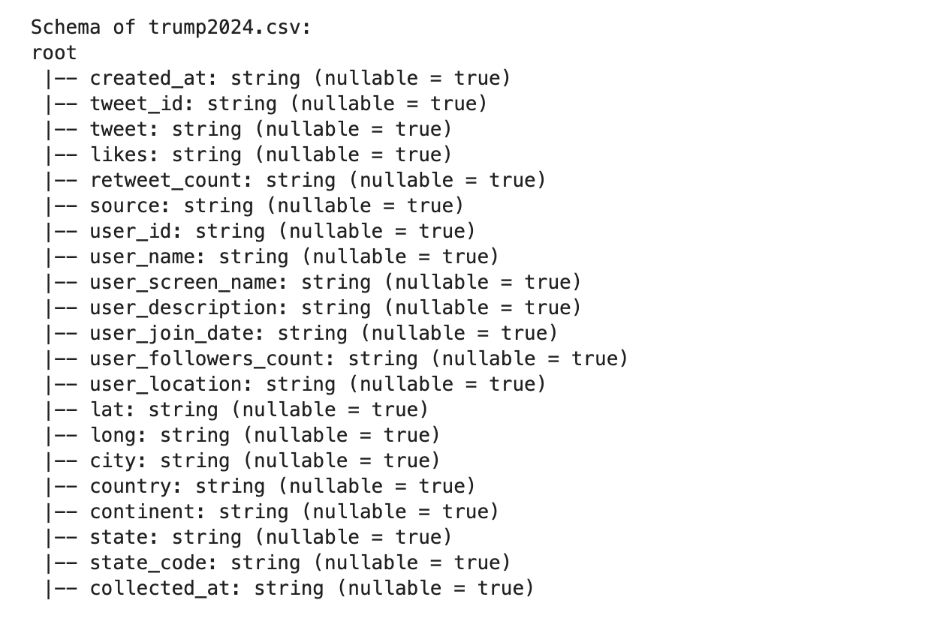
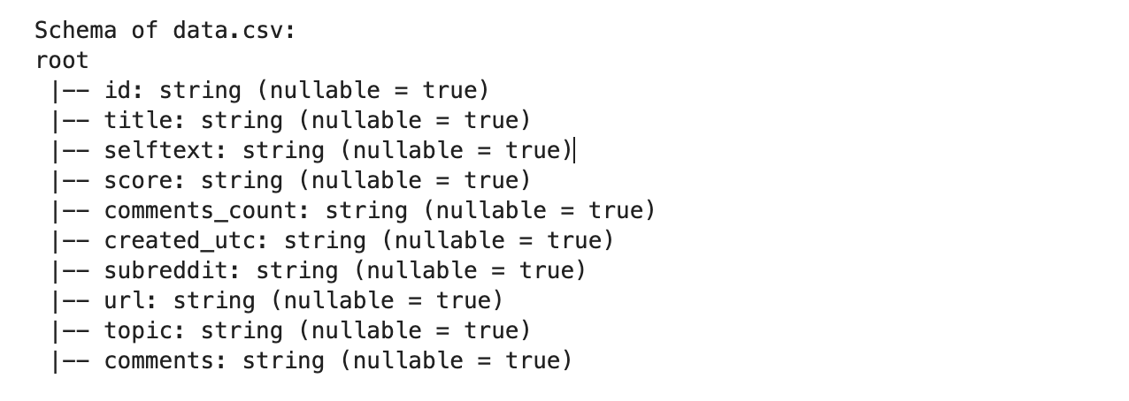
Let’s talk about Scraped Data….
Initial Data
Final
Data
Feature Engineering using Spark, made our lives much easier!

Slide 9
DATA PREPROCESSING!
P
Parallel Processing: Apache Spark distributes tasks across multiple nodes to process large datasets efficiently.
Data Loading:
Data is loaded in parallel from CSV files (data.csv, trumpfinal.csv), speeding up ingestion.
Data Cleaning:
Missing values are filled in parallel across the dataset.
Columns are cast to the correct data type (score, comments_count).
Outlier Removal:
IQR method is used to remove outliers from score and comments_count, calculated and applied in parallel.

Slide 10
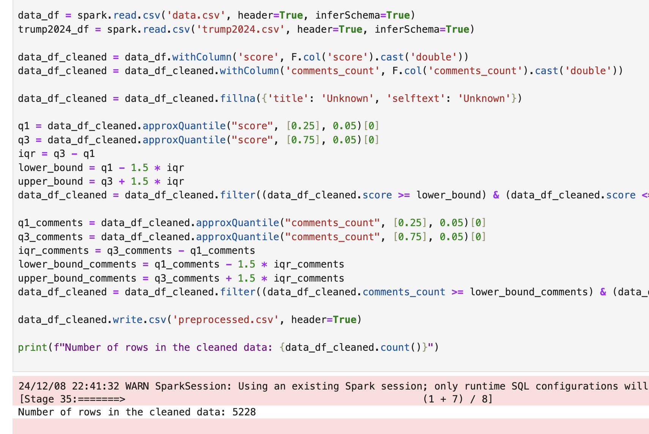
Contd…
Efficient Filtering:
Data is filtered for outliers in parallel, improving processing time.
Scalability: Spark's parallelism allows handling large datasets efficiently, scaling across a cluster.

Slide 11
Natural Language Processing!
Text Cleaning:
We used NLTK to process the text data by removing unwanted characters (such as hashtags and URLs) and converting the text to lowercase.
Stopwords Removal: NLTK’s stopwords corpus was used to filter out common words (e.g., "the", "and") that don't contribute much to sentiment analysis.
Lemmatization: The WordNetLemmatizer from NLTK was used to reduce words to their base form, ensuring that different forms of the same word (e.g., "running", "ran") are treated as one.
N-grams Generation:
Using NLTK’s ngrams, we generated bigrams and trigrams (2- and 3-word sequences) to capture word relationships and context within the text. We utilized the Spark Techniques taught in class to generate Bi-Grams and TriGrams using Spark.
Word Clouds:
We utilized NLTK in conjunction with the WordCloud library to visualize the most frequent terms in the datasets for both Kamala Harris and Donald Trump.

Slide 12
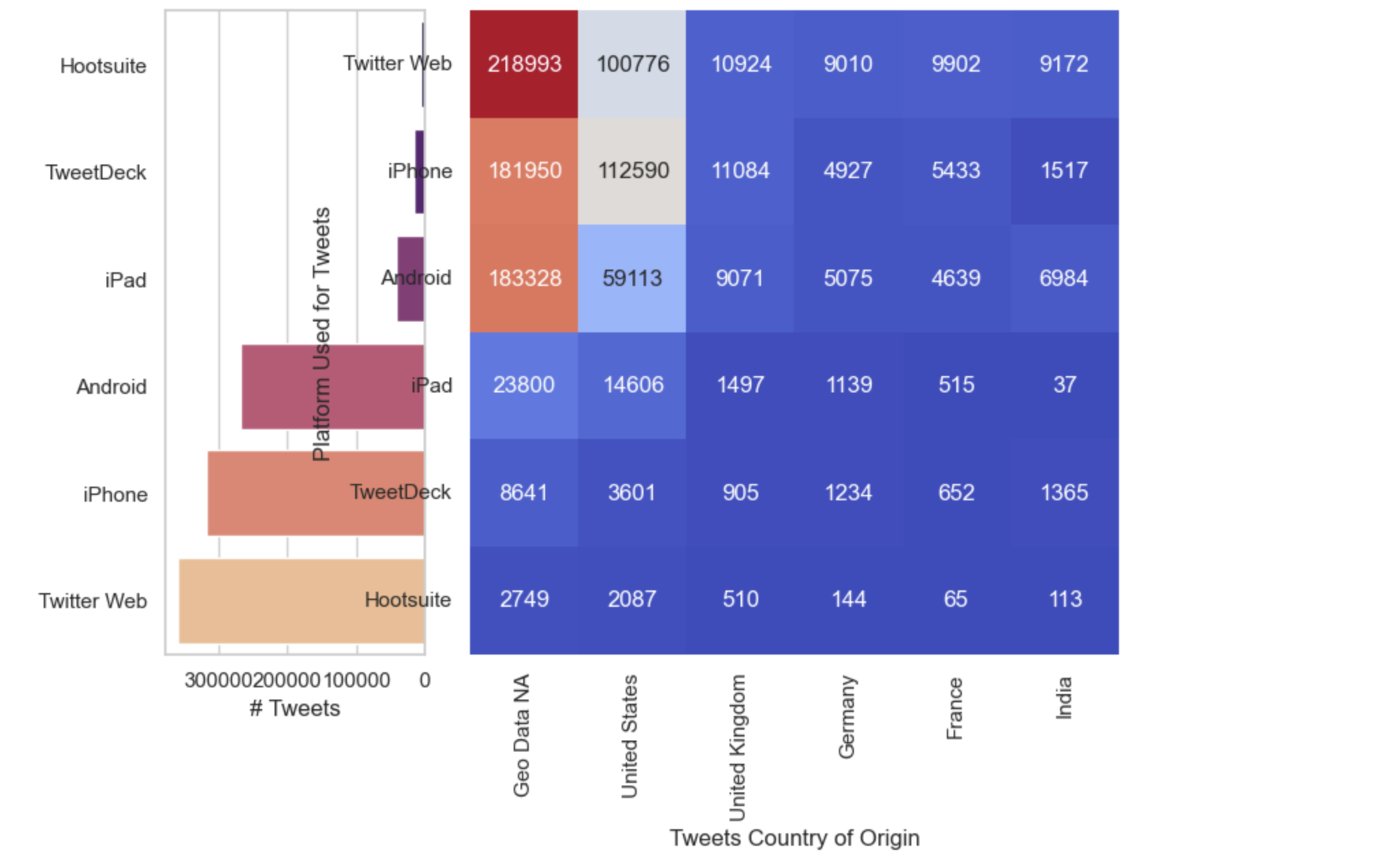
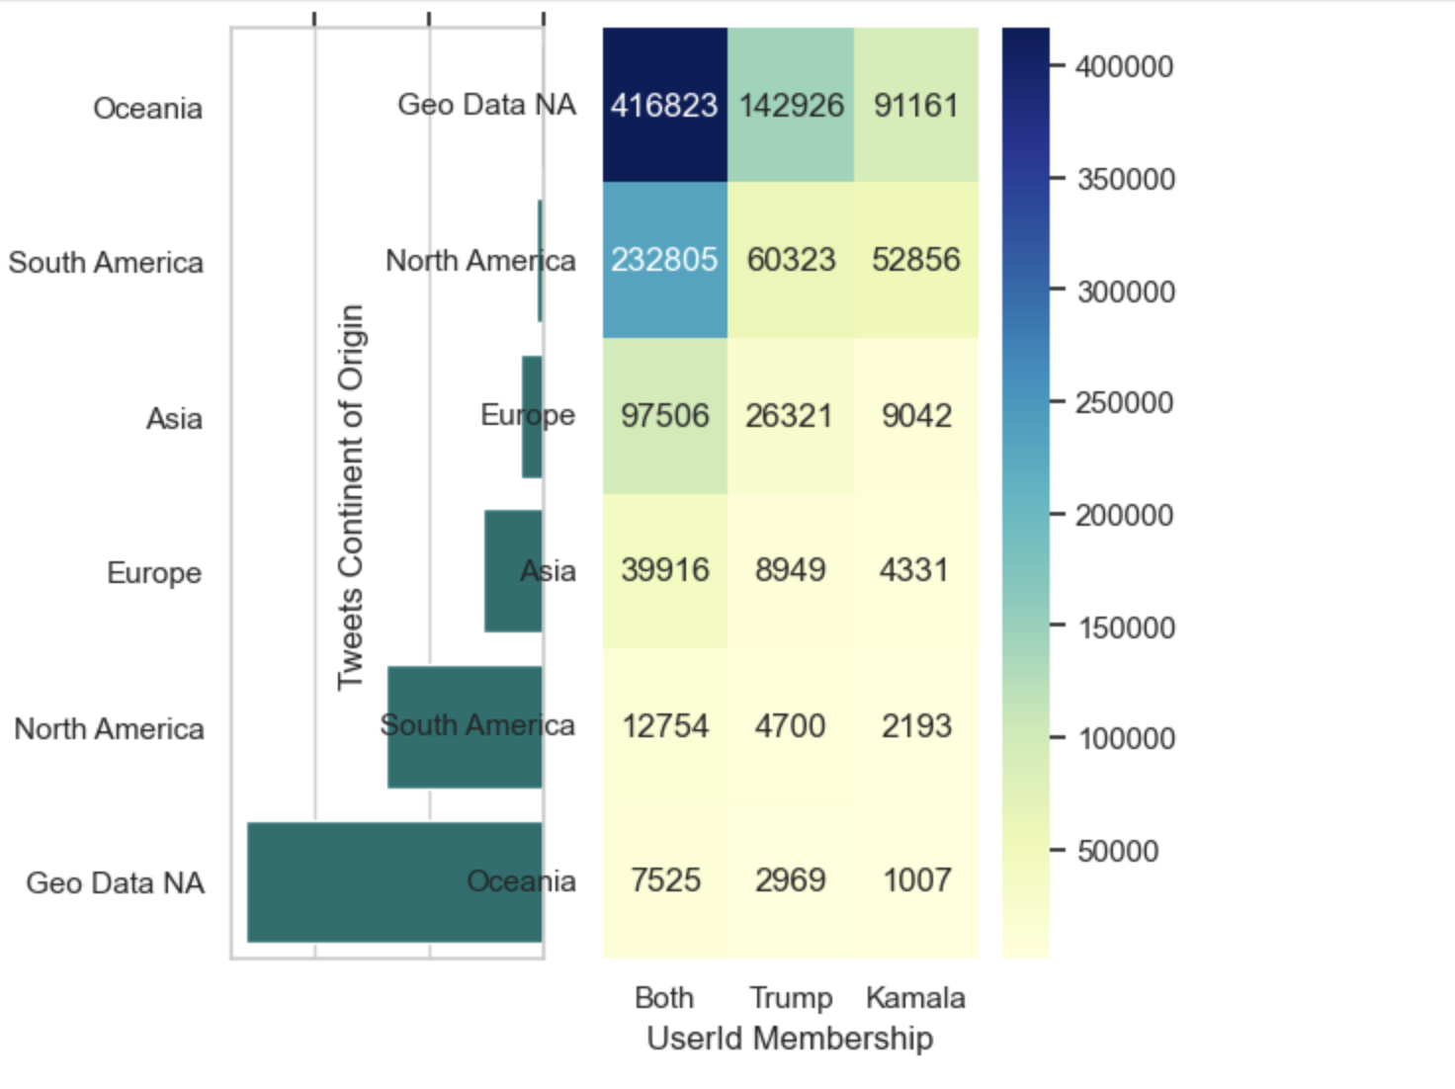
RESULTS - EDA
To find the number of tweets per origin (Kamala vs. Trump), we loaded the tweet datasets from CSV files, then processed them by normalizing certain columns like likes and retweet counts based on the time difference between tweet creation and collection. We also handled missing values and converted relevant columns like user_join_date and created_at into proper datetime formats. This data was then analyzed to determine the count of tweets originating from both Kamala and Trump, providing insight into their tweet activity.

Slide 13
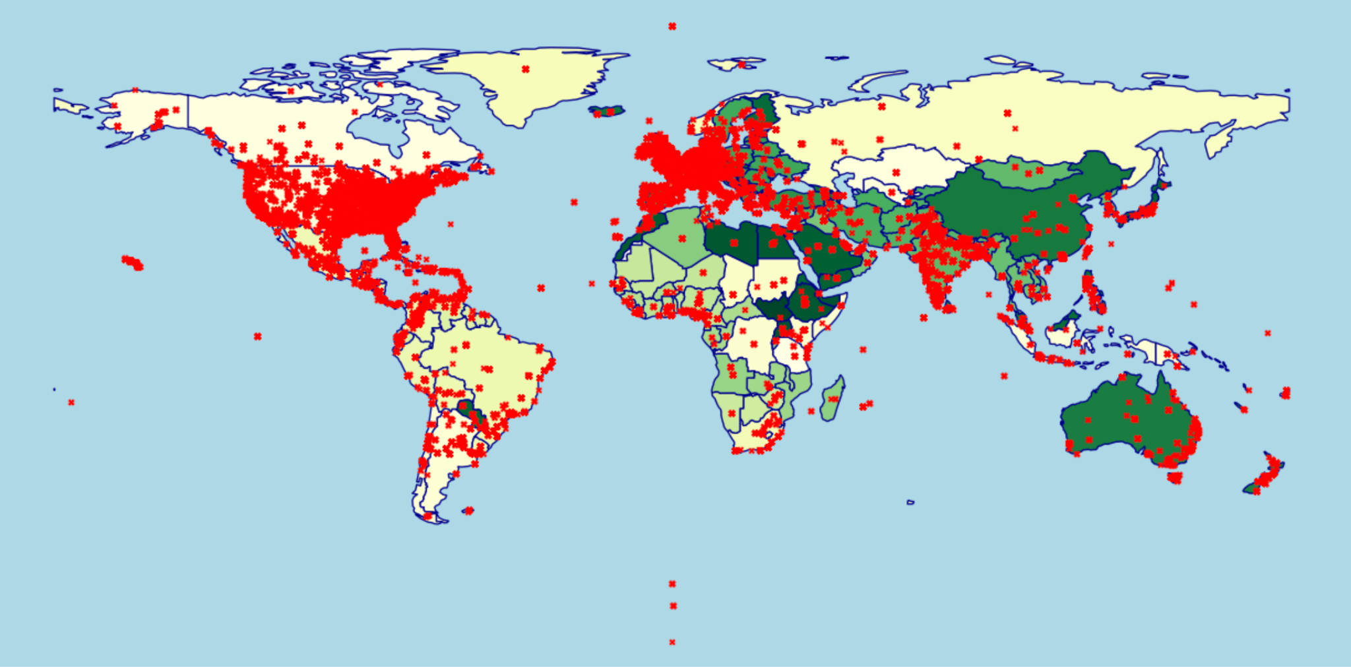
RESULTS!
We used GeoPandas to analyze tweet locations by mapping their latitude and longitude. The data was cleaned and then plotted on a map to visualize tweet origins. We used Seaborn to create heatmaps, highlighting areas with more discussion on the 2024 election. This allowed us to visually identify regions with higher tweet activity.

Slide 14
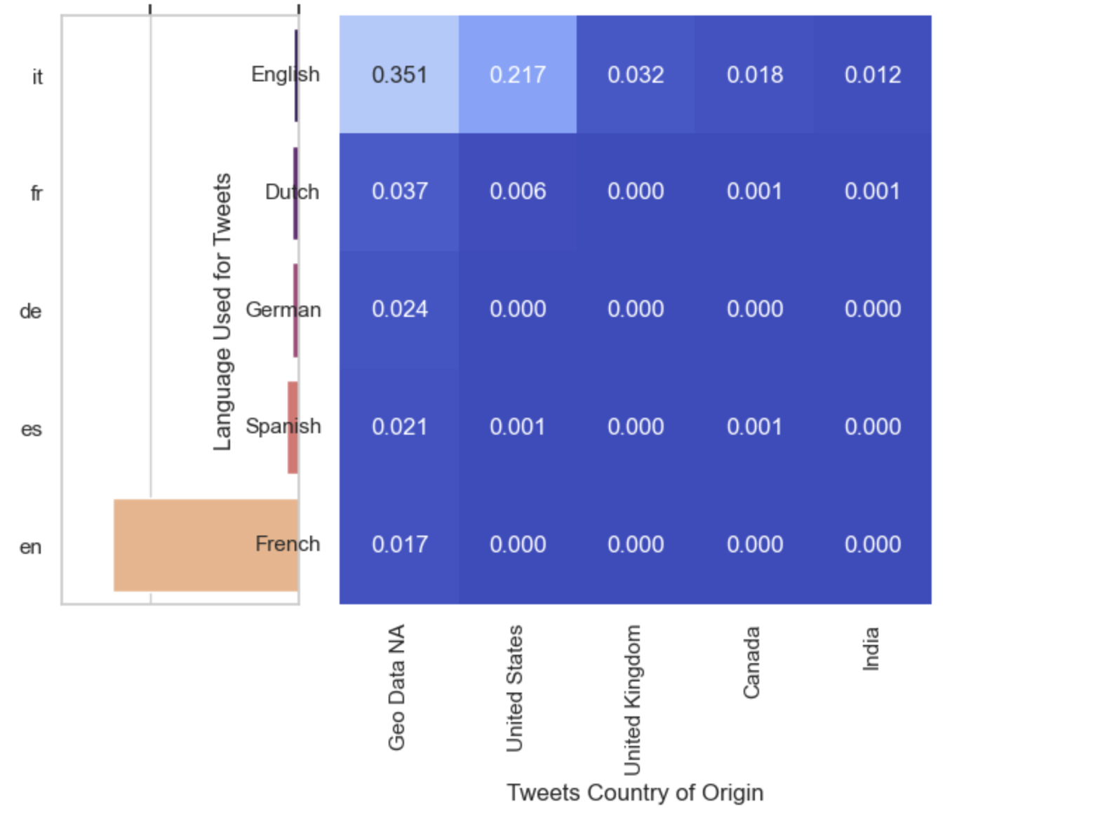
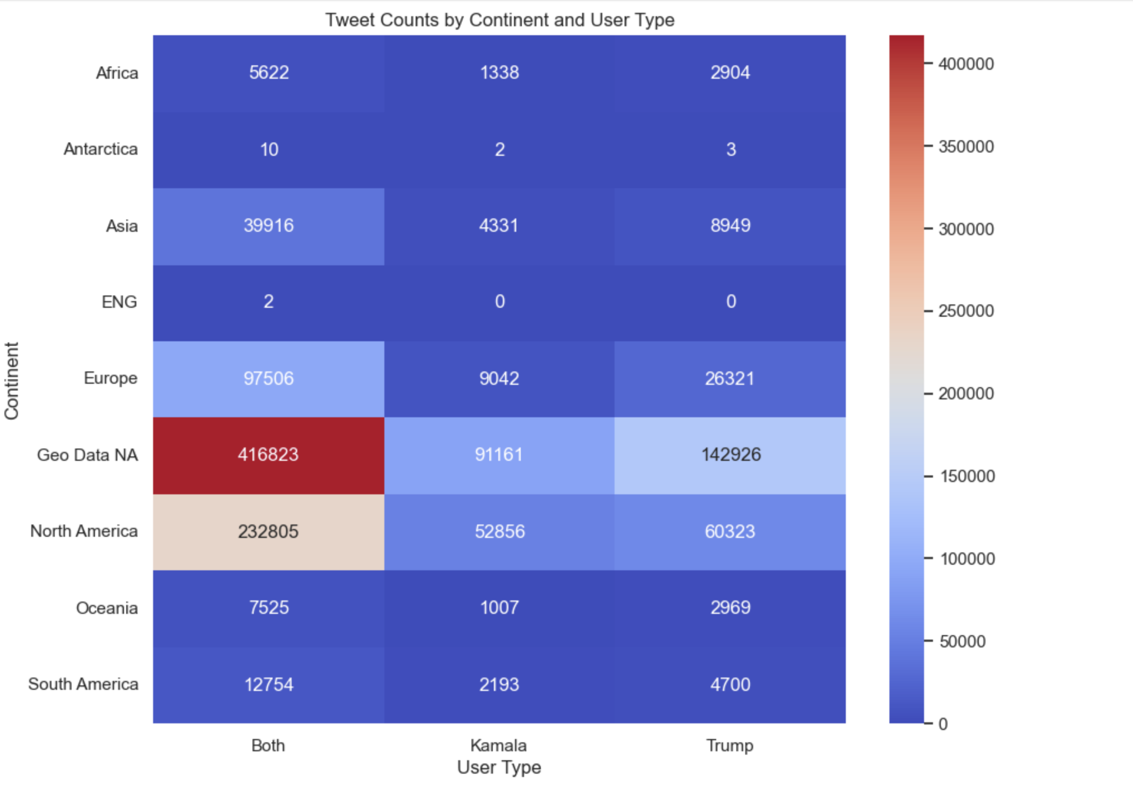
RESULTS!
We created a 2x2 subplot to visualize tweet language distribution across countries.
Heatmap: Shows the proportion of tweets in different languages for each country.
Bar Plot (Top-Right): Displays the total number of tweets per country.
Horizontal Bar Plot (Bottom-Left): Shows the total number of tweets per language.

Slide 15
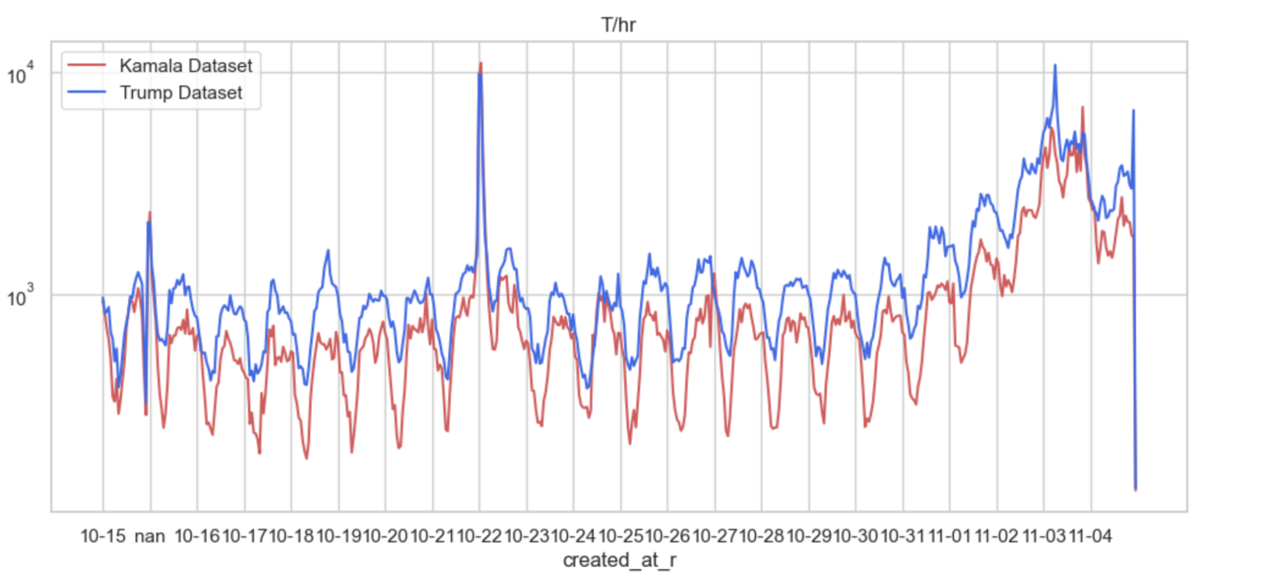
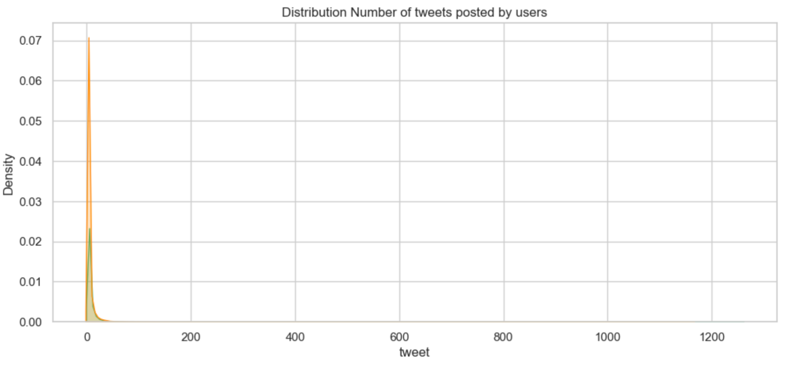
RESULTS!
We performed Time Series analysis to track tweet activity over time. This included analyzing tweets per hour, likes per hour, and retweets per hour. We used Seaborn to visualize the distribution of tweets per hour, revealing patterns in tweet activity and engagement over the course of the day. This analysis helped understand when discussions around the 2024 election were most active.

Slide 16
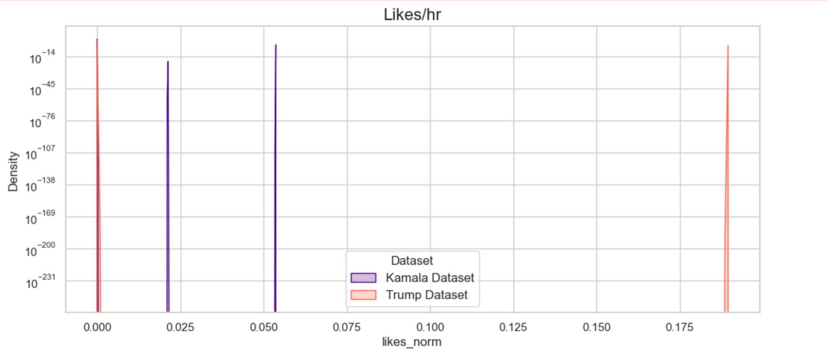
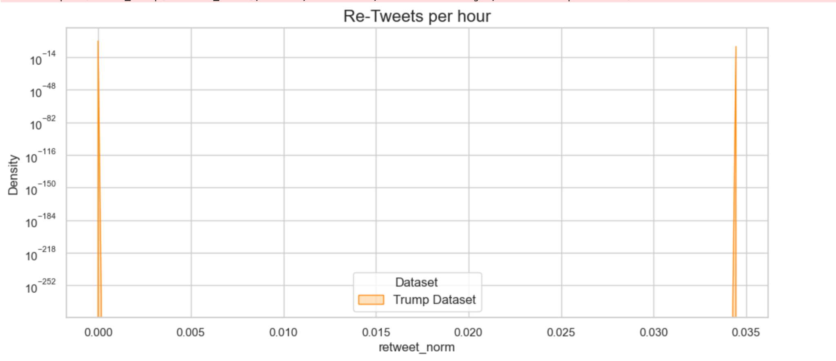

Slide 17
“IN GOD WE TRUST, ALL OTHERS BRING
DATA. ”

Slide 18
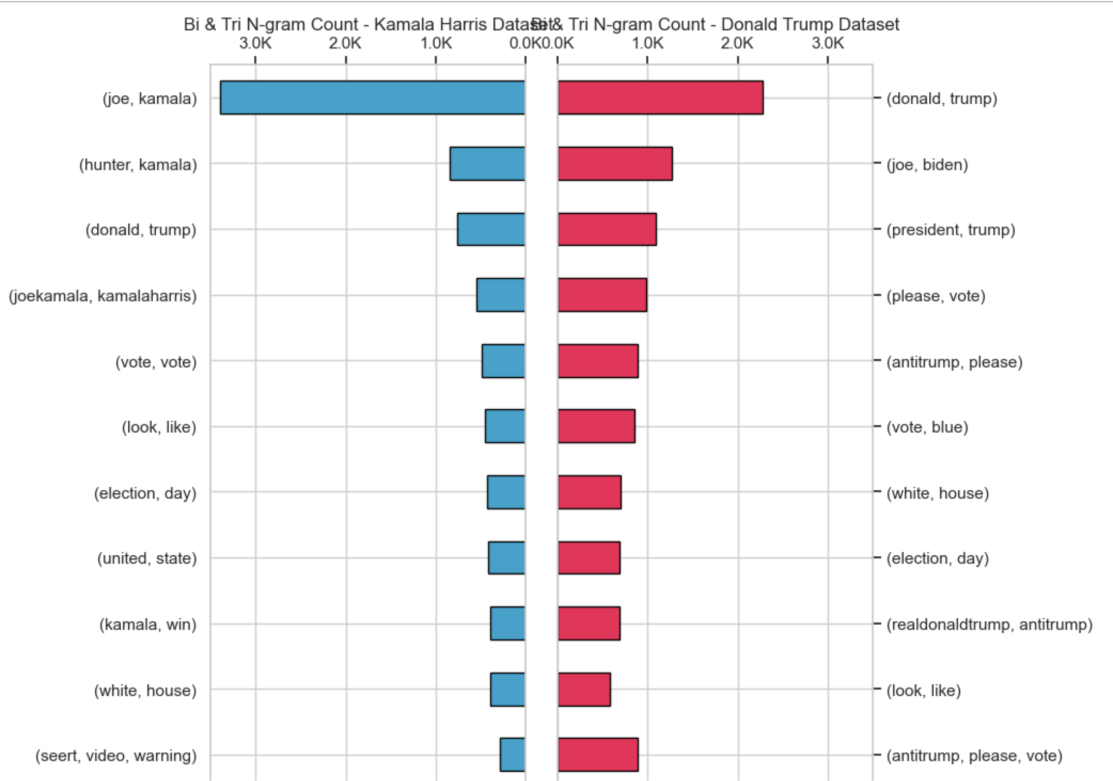
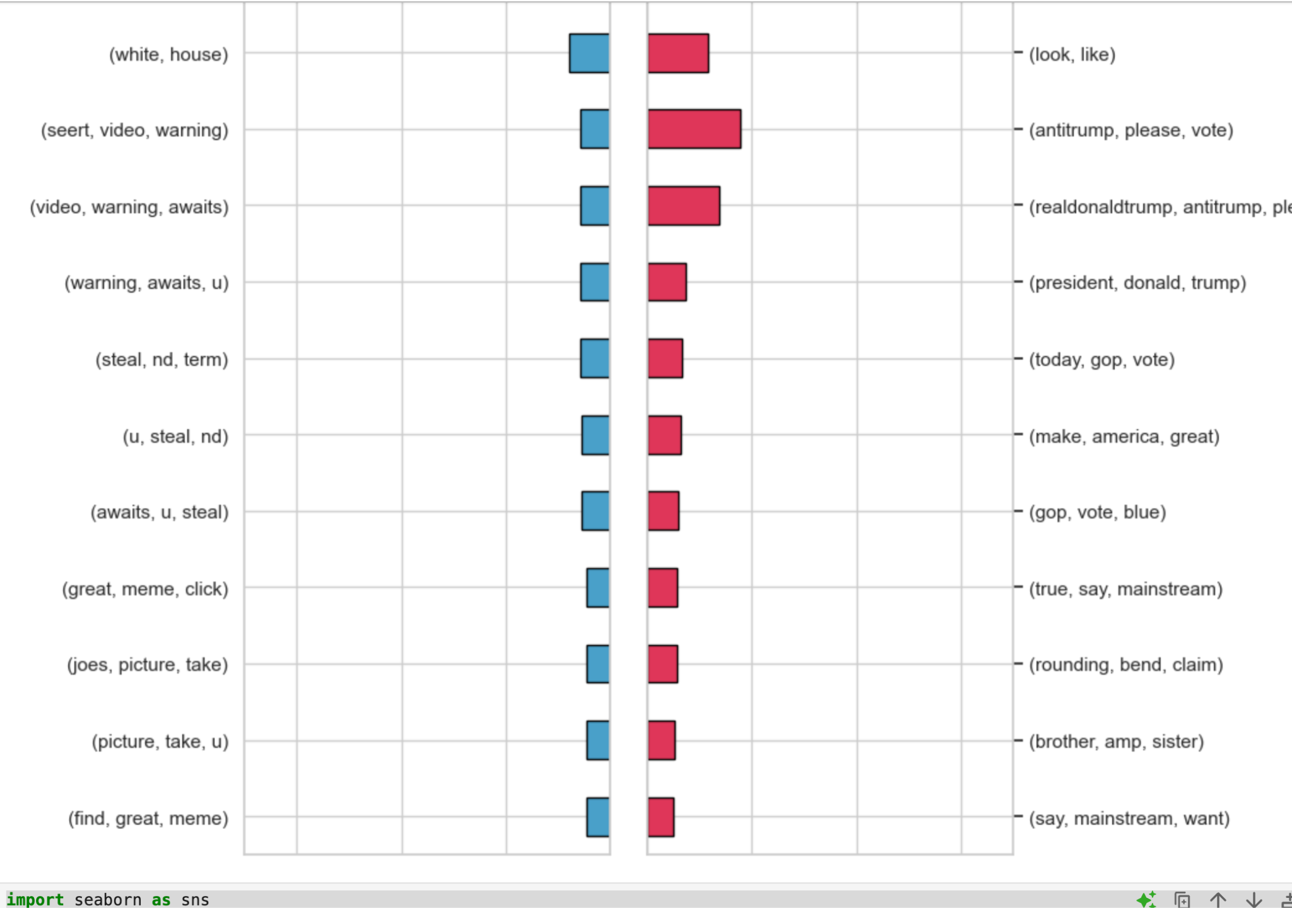
Finding most popular N-Grams for 2024 Elections!
We analyze the most popular n-grams (e.g., bigrams, trigrams) from the Election 2024 data to identify key topics, trends, and voter sentiments. By cleaning and tokenizing the tweet text, we generate n-grams and count their frequency. The most frequent n-grams reveal the major issues and concerns surrounding the election, helping us understand public opinion and sentiment. This analysis highlights the key themes shaping the election discourse.

Slide 19
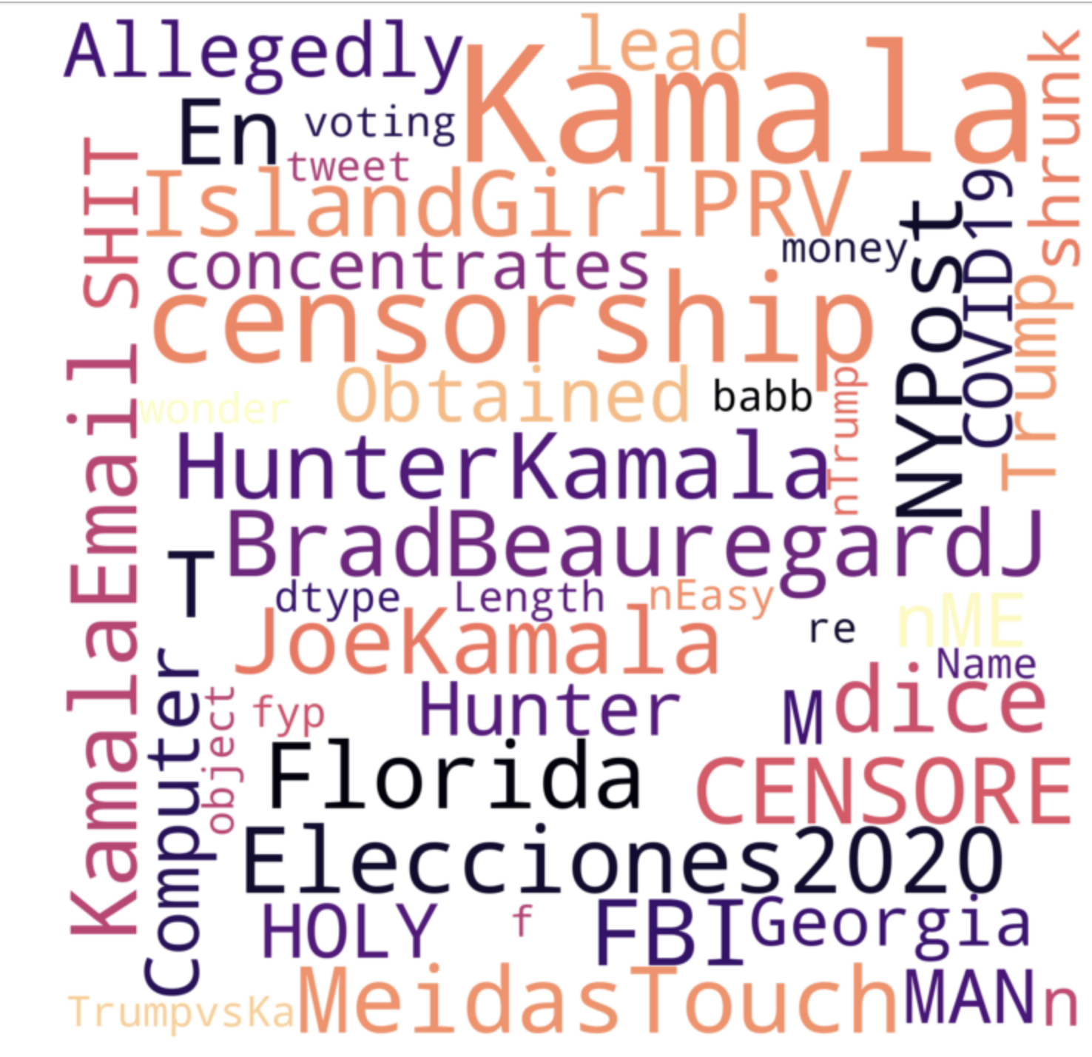
Identifying Key Topics: By analyzing the most popular n-grams, we can identify which issues or topics are being discussed the most in relation to the 2024 election.
Sentiment Analysis: Popular n-grams often reflect the tone of the conversation (e.g., positive or negative sentiment towards candidates, parties, etc.).
Understanding Voter Concerns: This analysis helps understand what voters and the public are most concerned about or excited about regarding the election.

Slide 20
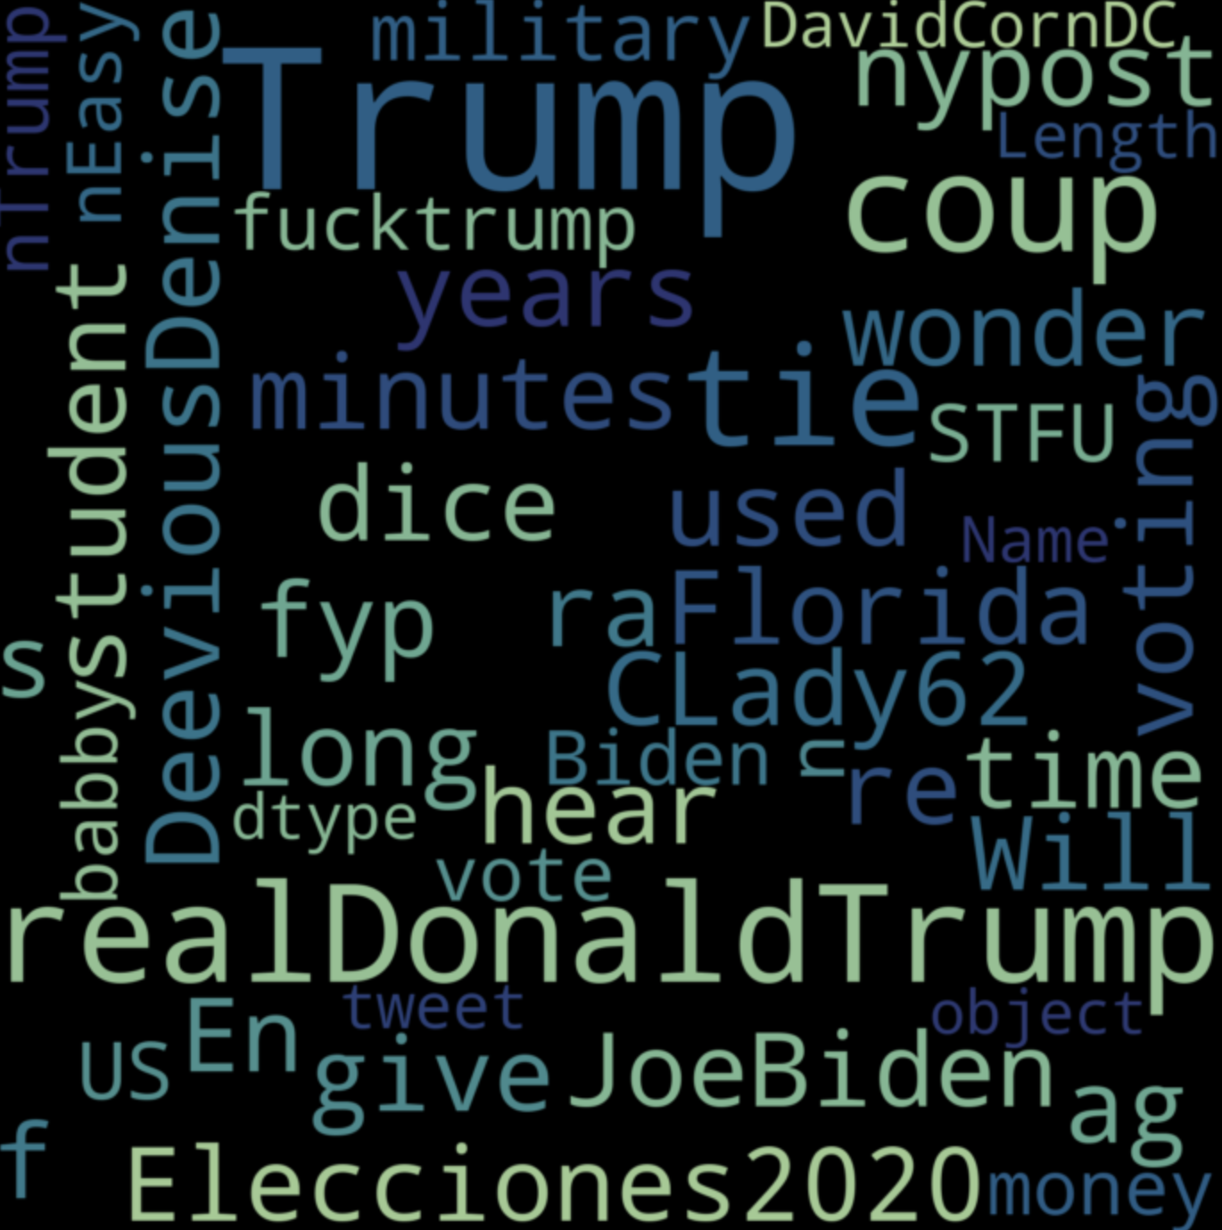
Sentiment analysis reveals public opinion, helping to predict future events. Positive or negative sentiments can indicate trends, like election outcomes or market shifts. By tracking sentiment over time, we can spot shifts in public mood that often precede major actions or decisions.
Although this cannot be the basis to predict the outcome, it is a super powerful tool used by Data Scientists to modulate their propaganda to aid their public perception, purely based on people’s sentiments.

Slide 21
HOW CAN WE IMPROVE FURTHER!
Deep Learning Integration: Apply models like BERT or LSTM to capture the nuanced context and emotions in tweets, improving sentiment detection, especially for sarcasm and irony.
Expand Feature Set: Incorporate additional data such as user demographics, tweet timing, and real-time events to provide richer context and track sentiment shifts over time.
Multilingual Analysis: Include multiple languages to capture diverse perspectives and broaden the analysis of election-related sentiment beyond English-speaking regions.

Slide 22
Concepts from the class used in the Project….
Parallelized Data Scraping using Spark
Parallelized Data Preprocessing using Spark
Reading Large Data using Spark
Applying NLTK and fastening it using Spark
N-Gram Techniques taught in Class.
One Key-Bucket Technique in MapReduce
And so on…

Slide 23
CITATIONS & INSPIRATIONS
https://www.kaggle.com/datasets/kashishashah/truthsocial-2024-election-integrity-initiative/data
https://www.usglc.org/2024-election-analysis/
https://towardsdatascience.com/forecasting-the-2020-us-election-using-multilevel-regression-with-post-stratification-bbf2f93585fb
https://www.kaggle.com/datasets/unanimad/us-election-2020

Slide 24
THANK YOU
TEAM AVENGERS

